Slide 1
Lesson 2
Requirements & Mission Design
Notes:
Lab #1
Skills review
HW#1 posted

Slide 2
Status
Where we’ve been
Where we are
Where we’re going

Slide 3
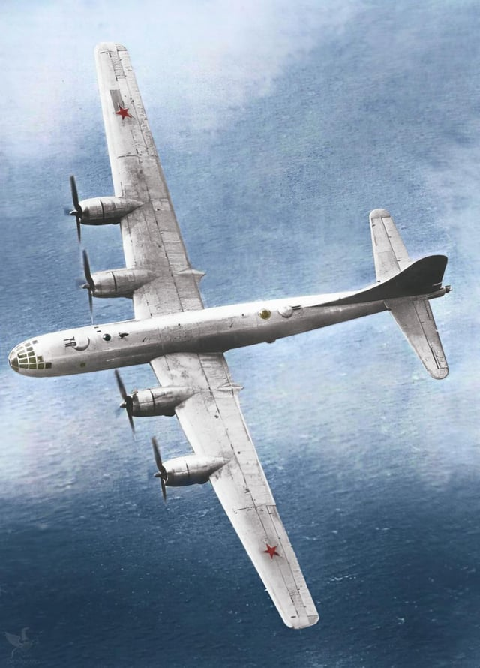
What plane is this?
Notes:
During World War II, the Soviet Union undertook one of the most ambitious reverse-engineering efforts in aviation history: the copying of the American Boeing B-29 Superfortress, which led to the creation of the Tupolev Tu-4.
The Context: Why the Soviets Wanted the B-29
By the end of WWII, the United States had demonstrated the unmatched capability of the B-29—especially with its long range, pressurized cabin, and ability to carry nuclear bombs. The USSR, while rapidly developing its aviation industry, lacked a comparable long-range strategic bomber.
In 1944, several B-29s made emergency landings in Soviet-controlled territory after bombing missions over Japan. According to the USSR's neutrality agreement with Japan, the Soviets were supposed to intern both the planes and crews. They did intern the crews (eventually repatriated in 1945), but they kept the planes.
Stalin's Orders: Copy It Exactly
Joseph Stalin personally ordered that the B-29 be copied down to the rivet. The effort was code-named “Project B” and assigned to Andrei Tupolev, a top Soviet aircraft designer.
Soviet engineers faced massive challenges:
All parts were in imperial units—the USSR used the metric system.
Materials and manufacturing methods differed—Soviets often had to create substitutes for American alloys, rivets, and wiring.
Some parts, like the central fire control system or pressurization components, were so advanced they had to be replicated from scratch.
Remarkable Success: The Tu-4
Despite the technical hurdles, in just three years, the Soviets unveiled the Tu-4 in 1947. It looked nearly identical to the B-29, and in fact, during a flyover at the 1947 Tushino Air Show, Western observers thought they were captured B-29s—until they noticed there were three of them.
While not a perfect replica—weight and performance slightly differed due to Soviet adaptations—the Tu-4 was a strategic game-changer. It gave the USSR a platform capable of delivering nuclear weapons to the U.S. mainland, closing a critical gap in Cold War military balance.
Legacy
The Tu-4 never saw combat but was a cornerstone of early Soviet nuclear strategy.
It laid the groundwork for future Soviet bombers, including the Tu-16 and Tu-95.
The operation remains a striking example of reverse engineering at national scale.
In a twist of irony, the B-29 was the world’s most advanced bomber in 1945—and by 1947, its clone was flying for its greatest rival.
Stalin’s demand for an exact copy of the B-29 was one of the most defining—and paradoxical—directives in the Tu-4 program. His insistence went far beyond the usual military requirement of “matching capabilities” and became a kind of political and psychological mandate for Soviet industry.
🪖 Why Stalin Wanted an Exact Copy
1. Time Pressure
By 1944–45, Stalin knew the U.S. had a bomber that could deliver nuclear weapons over intercontinental distances—something the USSR did not have. Developing an indigenous design from scratch would take 5–10 years. Reverse engineering could cut that to 2–3 years.
2. Proof of Soviet Capability
The exact-copy order was partly a propaganda tool. If the Soviets could reproduce the most advanced bomber in the world “down to the last rivet,” it would demonstrate to the world—and to Soviet citizens—that the USSR’s industry could match American technological achievements.
3. Avoiding Design Compromises
Stalin was deeply suspicious of engineers “improving” on foreign designs. In his eyes, any deviation might slow the program or reduce performance. Exact copying eliminated creative risk and kept the focus on proven success.
🛠 What "Exact Copy" Meant in Practice
When Stalin met with Tupolev, he gave instructions that were famously blunt:
"Make it exactly the same. Even the defects must be copied."
This meant:
No aerodynamic “improvements” (even though Soviet engineers were tempted to tweak wing profiles and control surfaces).
Same dimensions, shape, and systems layout—no resizing for metric tools unless absolutely unavoidable.
Even minor design quirks—like the arrangement of gun turrets—had to be replicated.
This frustrated engineers, because they already knew that some American solutions weren’t optimal for Soviet manufacturing or materials.
⚠️ Engineering Consequences
Imperial-to-Metric Clash The “exact copy” rule meant they couldn’t freely choose metric equivalents—they had to match the original dimensions and tolerances, forcing them to build nonstandard parts for the first time in Soviet aviation.
Reproducing Known Flaws If the B-29 had a maintenance nuisance, the Tu-4 inherited it. For example, some access hatches and equipment placements that American crews disliked were deliberately replicated.
Material Substitutions by Stealth While outwardly identical, some internal components had to be redesigned to work with Soviet alloys and lubricants, but these were done quietly to avoid violating the spirit of Stalin’s order.
🕵️ Political Dimension
Stalin’s insistence was also about control:
Tupolev had previously been imprisoned during the purges; this was effectively a test of loyalty.
By ordering an exact copy, Stalin could more easily measure “success” and punish failure—a design that differed too much from the B-29 could be seen as defiance.
📜 Outcome
By 1947, the Soviets rolled out the Tu-4, so visually identical to the B-29 that American observers at the Tushino Air Show initially thought they were looking at captured U.S. bombers. But internally, despite Stalin’s order, the Soviets still had to make hundreds of micro-adjustments because of materials, tooling, and manufacturing realities.

Slide 4
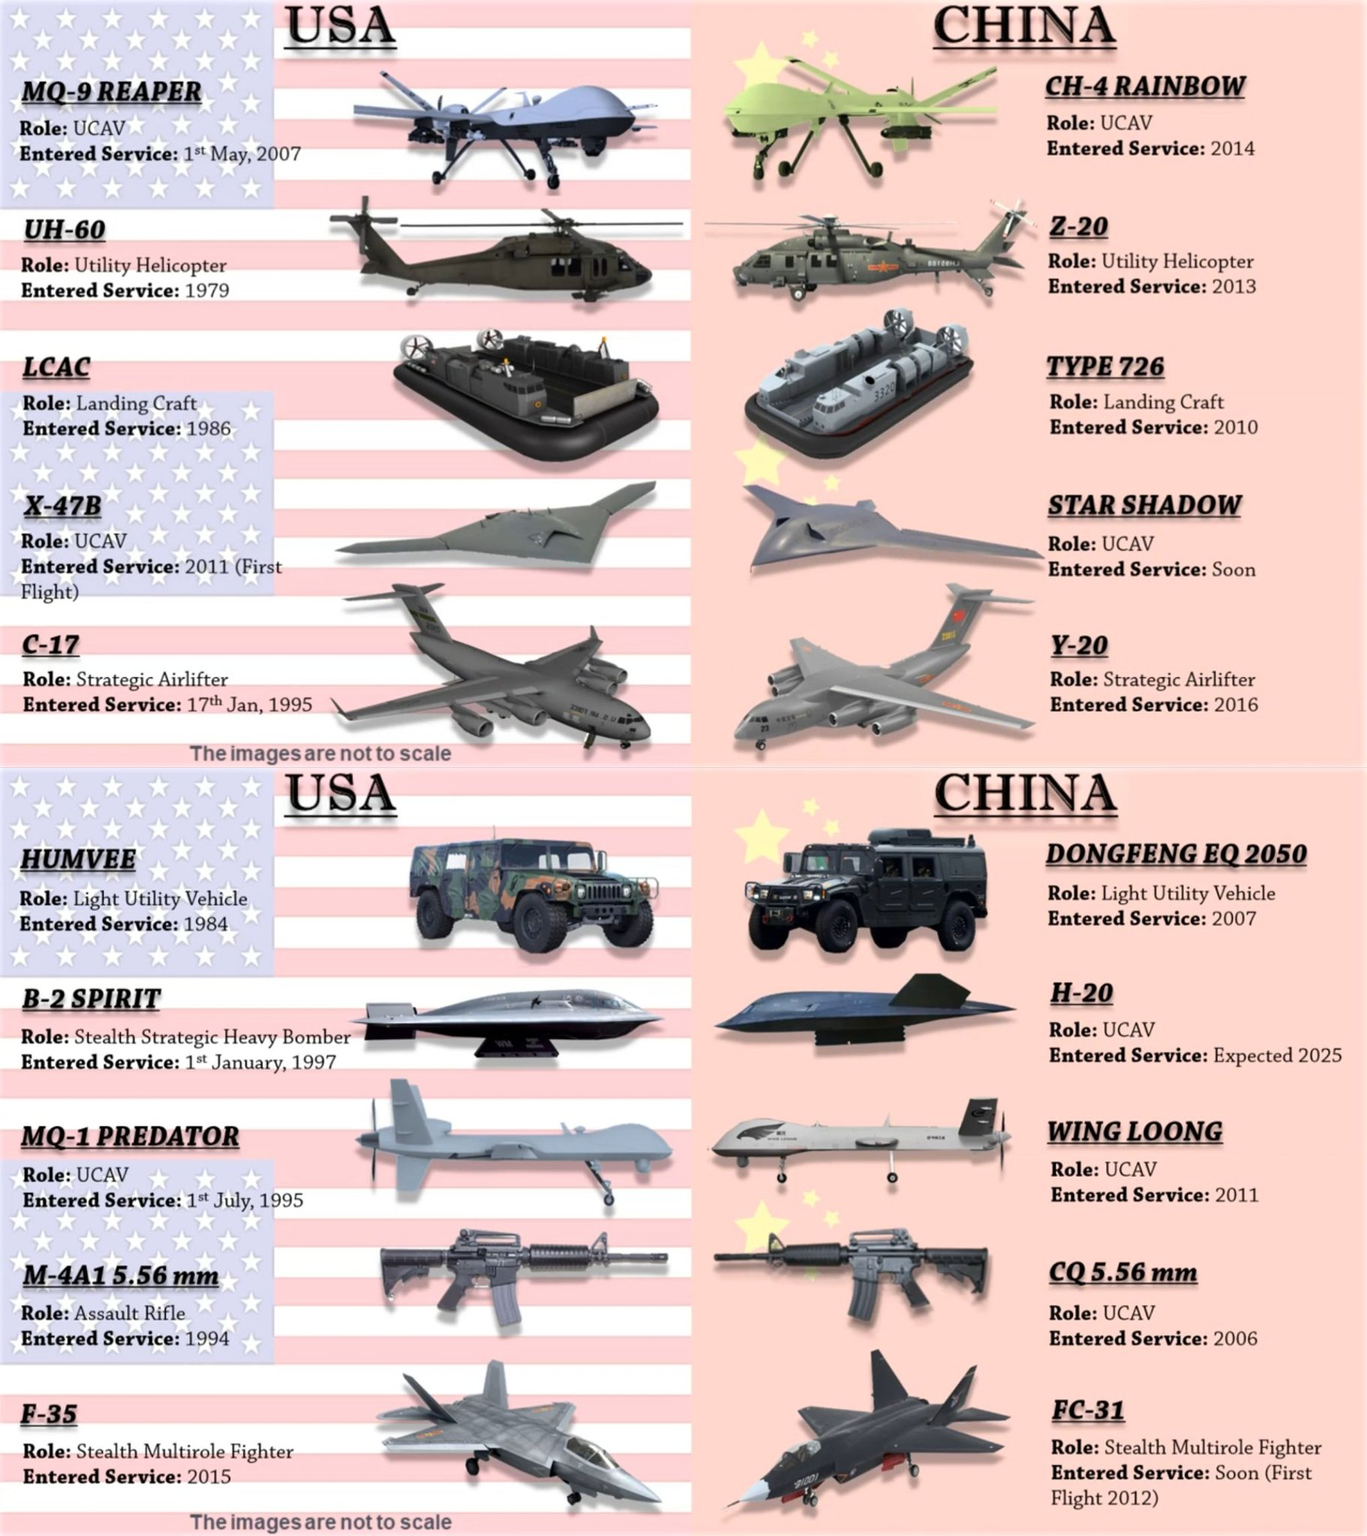
Reverse Engineering
Notes:
China has a long and well-documented history of reverse engineering foreign military systems, and it’s been a core part of how the People’s Liberation Army (PLA) rapidly modernized its capabilities over the last several decades. This practice has involved everything from opportunistic capture of hardware to acquisition via trade, espionage, and technology transfer under civilian or commercial cover.
I’ll break it down into historical context, methods, and examples, then cover impacts and limitations.
1. Historical Context
Post–Korean War through the Cold War – China’s early military technology base was largely Soviet-supplied. After the Sino-Soviet split (early 1960s), China continued copying Soviet systems, often with incomplete technical data, forcing them to “fill in the gaps” through domestic R&D.
Late 1970s–1980s – With normalization of U.S.–China relations, China got access to some Western technology (aircraft avionics, artillery fire-control, etc.) through commercial deals and joint projects, many of which were later leveraged into indigenous designs.
1990s onward – After the 1989 Tiananmen sanctions and collapse of the Soviet Union, China relied heavily on imported Russian weapons—fighter jets, surface-to-air missiles, submarines—and then domestically reproduced them.
2000s–Present – Rapid advances in China’s industrial base, plus cyber-espionage, have made reverse engineering faster, more precise, and more integrated with indigenous innovation.
2. Methods Used
Physical Capture
Acquiring wreckage of foreign aircraft, missiles, and drones—either from crashes inside China or from third-party conflicts.
Licensed Production → Unauthorized Derivatives
Building systems under license from Russia or others, then producing modified versions without further agreements.
Cyber/Espionage
Stealing design files, manufacturing blueprints, and source code for military systems.
Commercial Cover
Buying dual-use technologies (composite materials, jet engine components, electronics) under civilian pretenses.
Collaboration with Allies/Partners
Obtaining tech indirectly via partner nations with looser export controls.
“Parts First” Reverse Engineering
Disassembling imported systems component-by-component to understand metallurgy, electronics, software, and integration.
3. Notable Examples
Aircraft
J-11B – Reverse-engineered from Russian Su-27SK Flanker after licensed assembly in China; uses Chinese avionics, engines, and weapons.
J-15 “Flying Shark” – Based on a prototype Su-33 carrier fighter acquired from Ukraine.
J-20 – Incorporates design elements reminiscent of U.S. F-22 and F-35, possibly informed by cyber theft of stealth fighter data.
Missiles
HQ-9 SAM – Often compared to the Russian S-300, with some features resembling U.S. Patriot systems.
YJ-series anti-ship missiles – Derived from Soviet/Russian designs, with guidance influenced by Western technology.
Naval Systems
Type 052C/D destroyers – Integrate phased-array radars and VLS cells reminiscent of U.S./European AEGIS-type systems.
Drones
CH-4 UAV – Strong visual and performance similarities to U.S. MQ-9 Reaper.
4. Impacts & Limitations
Advantages
Rapidly closes technology gaps without full R&D investment.
Allows PLA to field systems with capabilities close to advanced peers faster than starting from scratch.
Reduces reliance on foreign suppliers over time.
Drawbacks
Reverse engineering without full design know-how can lead to reliability and performance issues (e.g., Chinese jet engines historically underperform Russian originals).
Creates dependency on continual acquisition of foreign designs for leapfrog advancements.
International trust and IP disputes can hurt legitimate defense exports.

Slide 5
Requirements

Slide 6
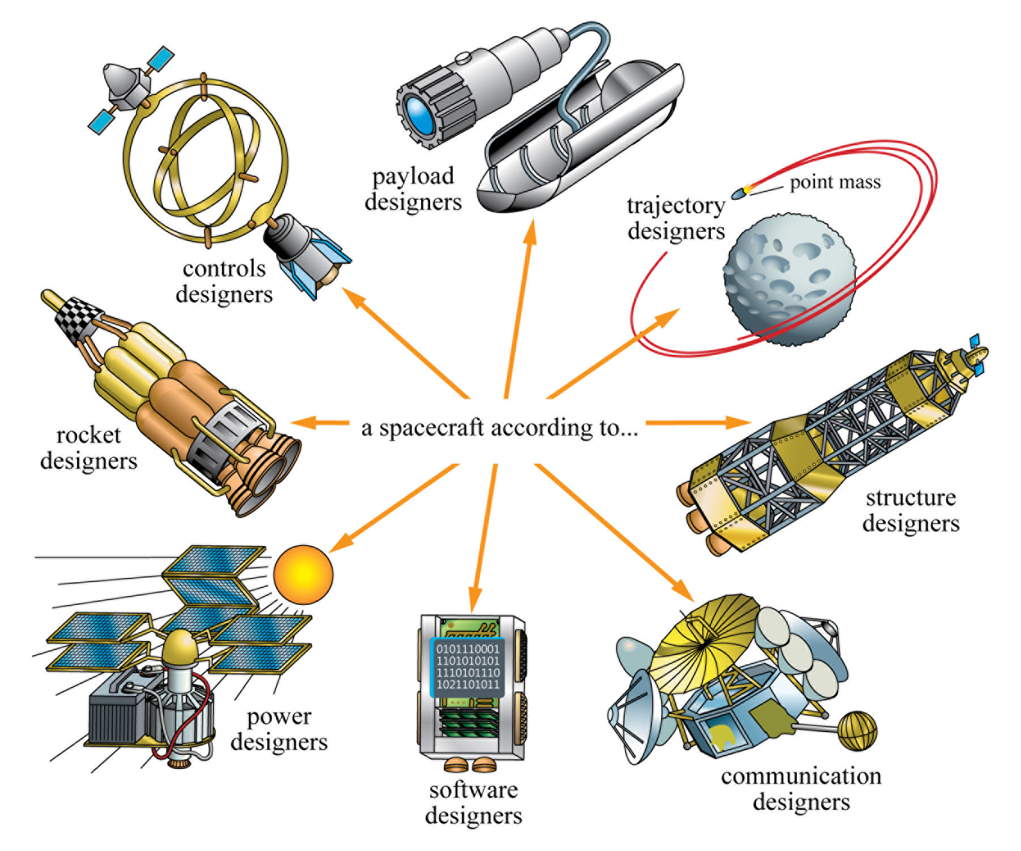
A spacecraft according to…

Slide 7
Exercise
Task: At the board with your table, spend 2-3 min proposing a space mission
Who are you (what organization)?
What is your problem?
What do you want from your system?
Why do you want it?

Slide 8
Requirements
A requirement is a clear, measurable statement of what a system, subsystem, or component must do, be, or meet to fulfill its mission objectives and satisfy stakeholder needs.
Derived from the stakeholder’s need for a new capability.
Formally defines what has to be accomplished in order to meet those needs.
Requirements are usually written as sentences or paragraphs.
Examples:
(1) Attitude control system will maintain bus pointing of less than 1 degree.
(2) Star sensors will provide bus orientation knowledge with a maximum expected error of 0.2 degrees.

Slide 9
The Importance of Requirements
Requirements problems are the single biggest cause of project problems.
Requirements define what is to be done, how well and under what constraints - get the requirements wrong and the design and hardware will be wrong.
Many teams begin to solve a problem before there is agreement on what the problem is.
→ Requirements and their associated constraints and assumptions quantify the problem to be solved - they establish how project success will be determined.
Requirements drive…
Cost - Design - Schedules - Skills required - Verification plans - Operational procedures - everything

Slide 10
The Importance of Getting the Requirements Right
100
Costs Committed
80
Cost (%)
60
Costs
Incurred
40
20
0
Requirement
and Concept
Development
Detailed
Design
Production
Time
Requirement and concept development commit costs before they are incurred.

Slide 11
Types of Requirements
Functional - Requirements which define what an item must do.
The system shall provide communications between the ground and the spacecraft.
Performance - Requirements which define and quantify how well an item must accomplish a particular function.
Provide communications over what range, with what data rate and how often
Constraint – Requirements that capture limitations such as schedule, budget, operational, environmental, safety or regulatory limitations. Often externally imposed. Examples:
The communications system shall use X-band frequencies.
The maximum RF power density shall be less than 10 watts/m² [due to regulation]
Design standards (e.g., metric units, programming language, etc.)
Verification - Requirements capture how confidence will be established that the system will perform in its intended environment.
All performance and functional requirements shall be met while the system is in a vacuum chamber with 2.5 Kwatts/m² of visible light illuminating the z-side.
Notes:
Constraints:
Externally imposed condition, limitation, or restriction that affects the system’s design, development, or operation.
Common criteria for constraints:
Scope – what are required/expected of the project?
Time – when will the project need to be finished?
Cost – how much money is provided?
Quality – what is the expectation of the outcome? high or just okay?
Resources – who are the working team members? what equipment/materials are provided?
Risk – what can go wrong with the project and how to deal with them?
Key Points About Constraints
They limit design options but do not necessarily define performance.
They are often imposed by stakeholders, the environment, regulations, or available resources.
They can apply at any level: mission, subsystem, or component.

Slide 12
Good Requirements Are
SMART
Specific -
It must address only one aspect of the system design or performance
It must be expressed in terms of the need (what and how well), not the solution (how).
Measurable -
Performance is expressed objectively and quantitatively
E.g., an exact pointing requirement (in degrees) can be tested thus verified prior to launch.
Achievable -
It must be technically achievable at costs considered affordable
E.g., JWST early designs specified an aperture requirement eventually descoped due to technical issues with deployment.
Relevant -
It must be appropriate for the level being specified
E.g., requirement on the solar cells should not be designated at the spacecraft level.
Traceable -
Lower level requirements (children) must clearly flow from and support higher level requirements (parents).
Requirements without a parent are referred to as orphans, and need to be assessed for necessity of inclusion.

Slide 13
Properties of Good Requirements
Unique: no two requirements overlap or duplicate each other
Unambiguous: no misunderstanding of exactly what is required
Testable: practical way of determining whether delivered system actually meets requirement
Traceable: every high-level requirement is broken down into one or more low-level testable requirements and every low-level requirement supports a documented high-level requirement
Consistent: doesn’t conflict with other requirement
Specific: focuses on one thing
Essential: creates a deficiency if deleted
Complete: not missing any conditions or constraints that would distinguish an acceptable system from an unacceptable system

Slide 14
Rules for Writing Good Requirements
Requirements have mandatory characteristics:
Needed
Verifiable
Attainable: technically, cost, schedule
Each requirement should
Express one thought
Be concise and simple
Be stated positively
Be grammatically correct; free of typos and misspellings
Be understood only one way; they are unambiguous
Use consistent terminology to refer to the system/product and its lower-level entities
Comply with the project’s template and style rules

Slide 15
More Rules for Writing Good Requirements
What a requirement must state:
WHO is responsible
WHAT shall be done
Or HOW WELL something shall be done
Or under what CONSTRAINTS something shall be done
Requirement format: “WHO shall WHAT”
Uses active not passive voice
Example product requirements:
The system shall operate at a power level of…
The software shall acquire data from the…
The structure shall withstand loads of…
The hardware shall have a mass of…
Use the correct terms:
Requirements are binding - Shall
Facts or Declaration of purpose - Will
Goals are non-mandatory provisions - Should
Do NOT use “Must”

Slide 16
Do Not Use in Requirements
Subjective Phrases
Multiple Requirements in a single statement:
And
Or
Conditional Clauses
If
Once
When
Unless
Except
Although
Always
User-friendly
Easy
Simple
Rapid
Efficient
Several
State-of-the-Art
Improve
Maximize
Minimize
Optimize
Adequate
Flexible
Approximately
Modern
Versatile
As possible
Facilities
Support
High-performance
Large
Intuitive
Robust
Sufficient

Slide 17
Goodness Checklist: Is this Requirement…
Free of ambiguous terms?
Examples: as appropriate, etc., and/or, support, but not limited to, be able to, be capable of
Free of indefinite pronouns?
Examples: this, these
Free of unverifiable terms?
Examples: flexible, user-friendly, robust, light-weight, maximize, adequate, small, portable, easily - other “ly” words and other “ize” words
Free of implementation?
Requirement should state WHAT is needed, NOT HOW to provide it, i.e., state the problem not the solution.
Necessary?
Ask “Why do you need the requirement?”; the answer may lead you to the real requirement.
Free of descriptions of operations?
To distinguish between operations and requirements, ask “Does the developer have control over this?” “Is this a need the product must satisfy or an activity involving the product?”
Free of TBDs (To Be Determined)?
Use a best estimate and a TBR (To Be Resolved) with rationale when possible.
Notes:
Compliance Automation or Ivy Hooks?
Supplementary reading suggestion: PRODUCT REQUIREMENTS DEVELOPMENT AND MANAGEMENT PROCEDURE; Langley LMS-Pilot Procedure PRDM; Revision: R3 V1; 11/16/04

Slide 18
Example Requirements: Good or Bad?
The aircraft shall have three engines.
→ The aircraft shall meet the operation requirements with a single engine out.
The lunar lander shall include an airlock.
→ The lunar lander shall provide the capability for crew to ingress/egress while maintaining pressurization.
The crew shall have the capability to perform extra-vehicular activities (EVAs).
→ The vehicle shall allow extra-vehicular activities during operations.
The spacecraft shall maximize lifetime.
→ The spacecraft shall have a lifetime of at least three years.
The software shall display data in a user-friendly fashion.
→ The software shall display data as described in ICD 2345 Table 3.1.
Notes:
The aircraft shall meet the operation requirements with a single engine out.
The system shall allow a change of thread selection during operations.
The system shall have a lifetime of at least three years.
The software shall display data as described in ICD 2345 Table 3.1.

Slide 19
Rationale Captures the Motivation and Assumptions of a Requirement
The rationale of each requirement defines
Why a requirement is needed
What assumptions were made
What design effort drove the requirement
Other data that will be needed to maintain the requirement over time
Example
Requirement: “The truck shall have a height of no more than 14 feet.”
Rationale: 99% of all US interstate highway overpasses have a 14 foot or greater clearance. (Assumptions: The truck will be used primarily on US interstate highways for long-haul freight in the US.)

Slide 20
Space Example Requirement & Rationale
Requirement: “The Constellation Architecture shall provide communication and tracking services prior to launch, during all mission phases, through recovery.”
Rationale: Communication and tracking services must be provided to elements during all mission phases. Ground based assets can provide this capability to elements when in direct line-of-sight with Earth. The Space Network can support launch, operations in LEO, re-entry and landing. Earth-based comm. and tracking services cannot, however, support the lunar landing, lunar ascent, or lunar surface operations if they are at polar locations or on the far side of the Moon. Another infrastructure element, such as a lunar relay, must be provided to support communications and tracking to elements during operations on the lunar far side or at the poles.
This requirement does not imply continuous coverage.
Lower level requirements will specify continuity and type of coverage.

Slide 21
Exercise Cont.
Task: Create one of each type of requirement (functional, performance, constraint, verification) for your space mission.

Slide 22
Requirement Allocation and Closure
Allocation – breaking down higher-level requirements into lower-level, more detailed requirements, and assigning (allocating) them to specific subsystems, components, or teams responsible for meeting them.
Closure – satisfying lower-level requirements ensures system performance at the next higher level, and that we can trace all requirements back to satisfying mission needs
Notes:
Allocation
Purpose:
Ensure every part of the system has clear, testable requirements derived from top-level mission needs.
Maintain traceability from the original mission requirement down to each subsystem specification.
Example in a CubeSat mission:
Top-level requirement: The spacecraft shall capture 10 m resolution multispectral imagery from a 500 km orbit.
Allocated to payload subsystem: The imaging payload shall provide a focal length of 500 mm and a detector resolution of 1024 × 1024 pixels.
Allocated to ADCS subsystem: The attitude control system shall maintain pointing stability of ≤ 0.05° during imaging.
Allocated to comms subsystem: The downlink system shall transmit image data at ≥ 50 Mbps.
Closure
Purpose:
Provide documented proof to stakeholders that each requirement is met.
Officially mark the requirement as “closed” in the requirements management system.
Example in the same CubeSat mission:
Requirement: The attitude control system shall maintain pointing stability of ≤ 0.05° during imaging.
Closure evidence: Attitude performance measured in thermal-vacuum pointing tests shows stability of 0.03°, documented in test report ACS-TST-021.
Requirement status in the database changes from Open → Verified → Closed.

Slide 23
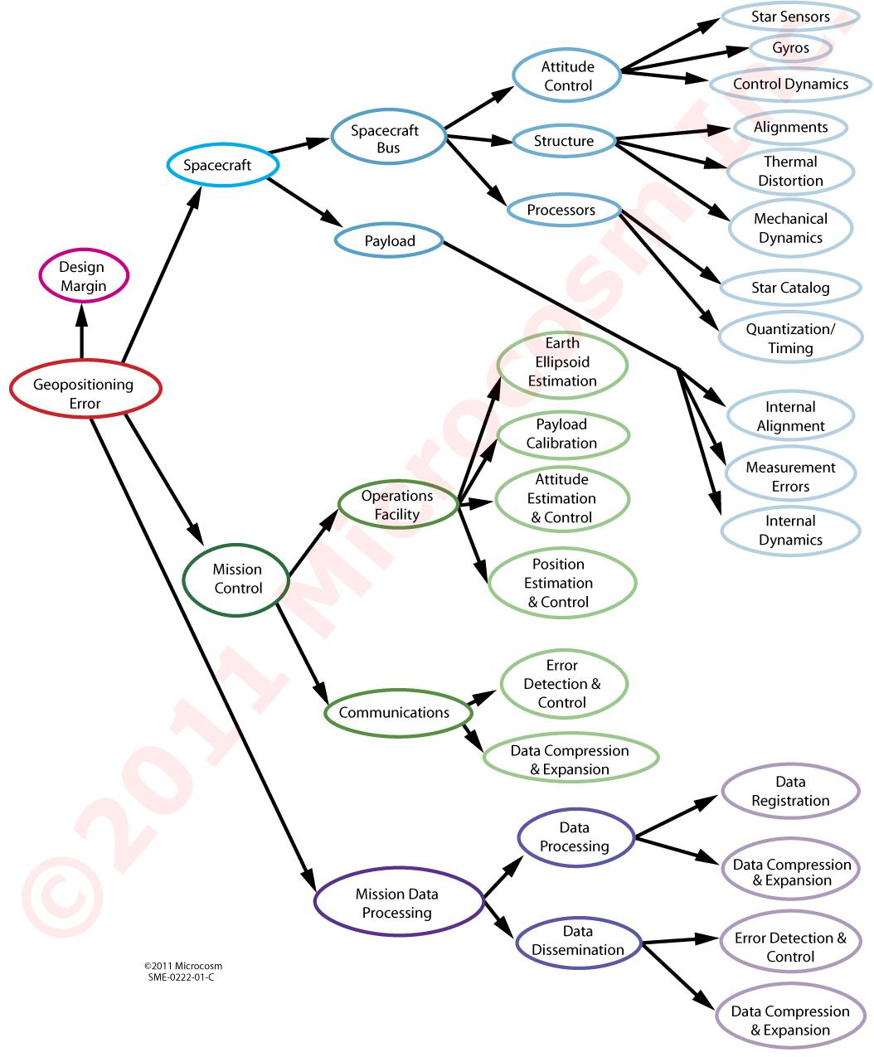
Requirement allocation (big-to-little/left-to-right) and closure (little-to-big)

Slide 24
Requirements Validation
Requirements validation is a process that asks 3 questions:
Do we have the correct problem?
Do our requirements capture this problem?
Are our requirements SMART?
Performed to assure the system requirements set is complete, consistent, and each requirement is achievable and verifiable.
Performed by subject matter experts, the system performing organization and the system authorized customer.
Does the requirement set completely address and accomplish the mission?
Are the requirements consistent with the established system boundaries and constraints?
When does requirement validation take place?
Before the System Requirements Review (SRR)
Notes:
Definition of SRR
A spacecraft System Requirements Review (SRR) is a crucial milestone to confirm all system needs are defined, understood, and achievable before detailed design, ensuring functional, performance, and constraint requirements (cost, schedule, tech readiness) align with program goals, creating a solid foundation for the initial design with minimal risk. It validates that requirements are consistent, testable, traceable, and form a coherent whole (requirements tree) for the spacecraft, agreed upon by the customer and developer.

Slide 25
Requirements Validation
Requirement Validation is the process of confirming the completeness, compatibility and correctness of the requirements.
Requirement Validation answers the questions: “ Are the system design requirements correctly defined and mean what we intended? “Is the set of requirements, or the specification, self-consistent?”
When does requirement validation take place?
Before design and during detailed design, i.e., mostly in Phase B and tapering down in Phase C
Ideally, completed prior to System Requirements Review (SRR)
What is importance of getting requirements validation right early in the project life cycle?
So when it comes time to verify the system, you are verifying to the right requirements.
Notes:
Additional thoughts on requirements validation.
Source: Goddard Procedures and Guidelines on Systems Engineering; GPG 7120.5; page 16
During the design phases performance predictions, trade studies, analyses are used to validate that the chosen design meets the requirements, when utilized according to the Operations Concept.
Validation also establishes requirements tracing to ensure that the higher level requirements flow to a lower level or child requirement. Requirements validation also makes sure that the lower level requirements have a parent requirement. Orphan requirements, ones without a higher level parent, are evaluated to determine if they are needed.
a. Requirements shall be validated to assure that the system will meet the Mission Objectives, be capable of performing the Measurement Concept, accommodate the Instrument Concept, and operates as defined in the Operations Concept.
b. Each project shall decide on the mechanism for tracking the requirements and who is responsible for the requirements flow and verification.

Slide 26
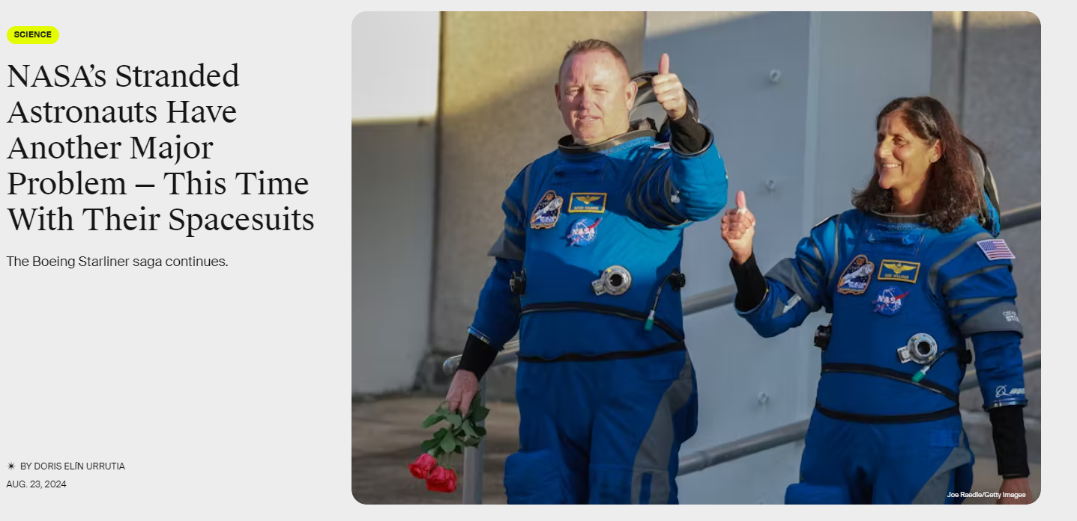
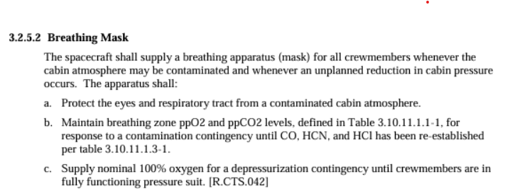
NASA Example (poorly defined requirement)
From: ISS Crew Transportation and Services Requirements Document:
Notes:
the spacesuits that Williams and Wilmore wore inside the Boeing Starliner are not compatible with other spacecraft.

Slide 27
ISS Crew Transportation and Services Requirements Document
Notes:
Show example of requirement and rationale

Slide 28
Mission Design

Slide 29
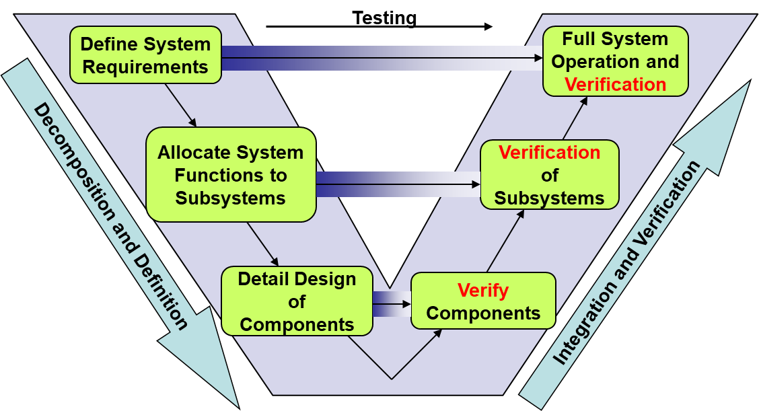
Systems engineering V-diagram
Notes:
verification at each level
verify complete system at the end
can’t verify complete system until the system is complete
need to verify components/subsystems along the way
allocation/closure
note what’s missing: build the system

Slide 30
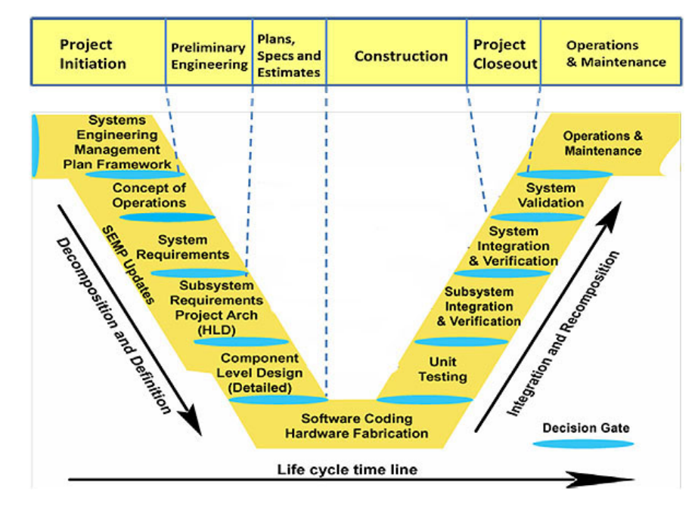
Systems engineering V-diagram (detailed)
Notes:
verification at each level
verify complete system at the end
can’t verify complete system until the system is complete
need to verify components/subsystems along the way
allocation/closure
note what’s missing: build the system

Slide 31
Development Cycle
General developmental process:
High Level Requirements
What is the mission trying to accomplish?
Concepts
What options could accomplish this?
Detailed Requirements
Be specific about critical aspects of the mission.
Design/Development
Figure out how to build a satellite to meet the requirements.
Production
Build that satellite(s).
Deployment
Get the satellite and ground systems in place.
Operations/Maintenance
Day to day functioning of the satellite.
Termination
Handle the end of life of the project.
This process is iterative!

Slide 32
Common Mission Milestones
SRR – System Requirements Review
SDR – System Design Review
SSR – Software Specification Review
PDR – Preliminary Design Review
CDR – Critical Design Review
TRR – Test Readiness Review
IOC – Initial Operational Capability
FOC – Full Operational Capability

Slide 33
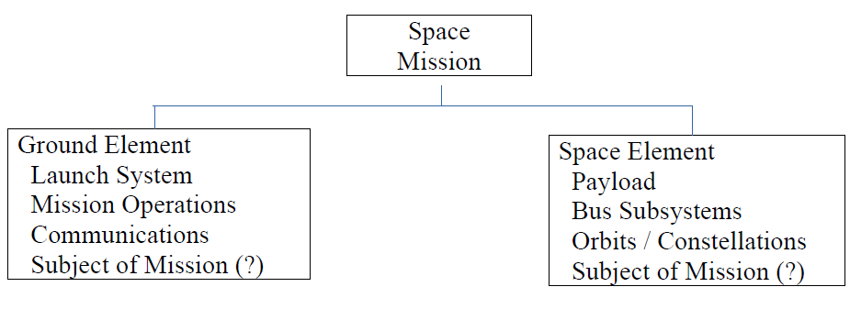
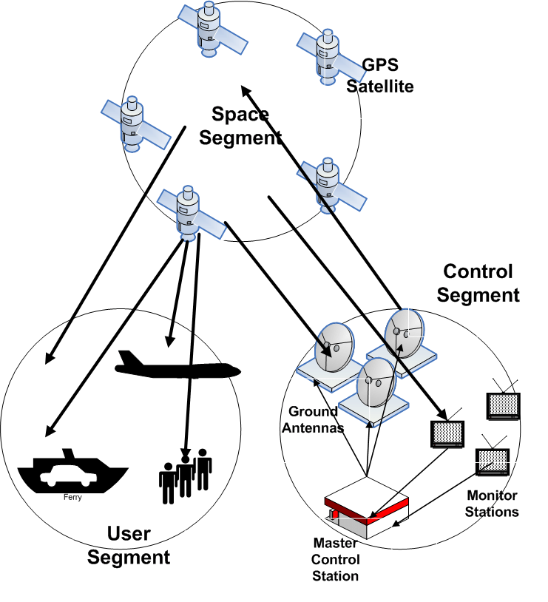
Mission Elements
Consider more than the satellite itself as an element of the mission. Examples:
Arbitrary Space Mission
GPS Mission Segments

Slide 34
Main Players
Sponsors/Stakeholders – People/organizations that specify the high-level requirements and provide funding. They are ultimately why the project exists. Sometimes referred to as ‘customer.’
Developers – Turn concepts and requirements into real hardware/software and a process that will meet the sponsors’ requirements.
Users – The people that will be tasked with operating the system or analyzing the data that comes from the completed system. The final result needs to be something that they can use.

Slide 35
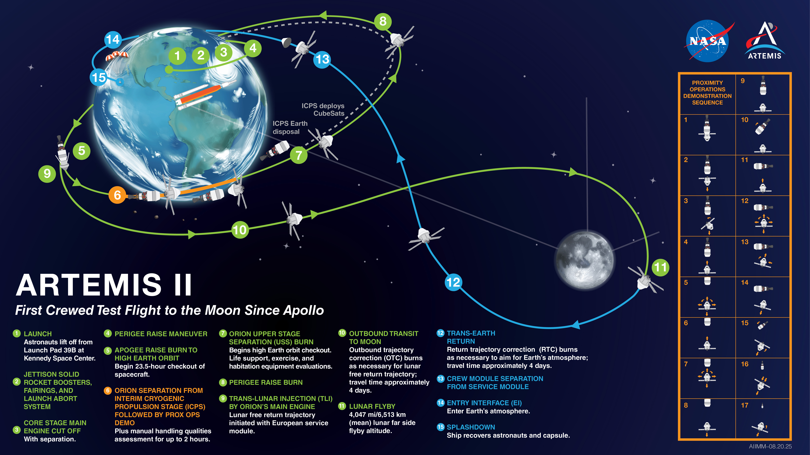
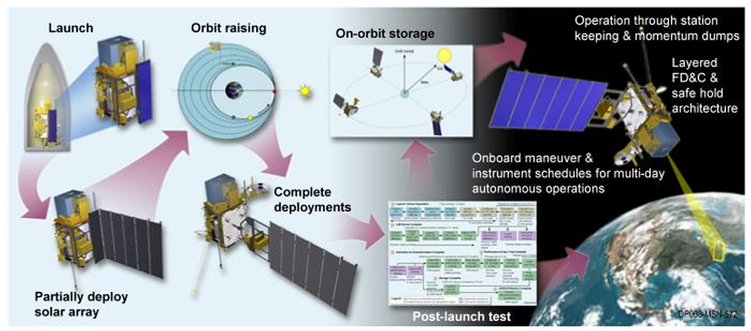
CONOPS
A Concept of Operations (CONOPS) describes how a mission is executed. Usually includes:
Goals and Objectives
Strategies and Policies
Interactions and Activities between all groups involved
Identification of who has Responsibilities
Identification of who has Authority
The Processes and Operation of the system
Plans for Startup, Normal Operations, and End of Life

Slide 36
GOES-R CONOPS Document
Notes:
The GOES-R Series (Geostationary Operational Environmental Satellites-R) is NOAA's advanced fleet of weather satellites, providing high-resolution imagery and data for improved forecasts of severe weather (hurricanes, tornadoes, fires), monitoring of space weather, and real-time lightning mapping, significantly enhancing public safety and economic well-being with faster, more detailed observations from geostationary orbit. The series includes four satellites (GOES-R, -S, -T, -U) launched between 2016 and 2024, with missions continuing through 2036.
Key Features & Capabilities:
Advanced Imaging: Offers rapid, detailed views (as often as every 30 seconds) of weather phenomena like clouds, smoke, and ash.
Lightning Mapper (GLM): The first operational geostationary lightning mapper, providing continuous lightning detection.
Space Weather Monitoring: Tracks solar activity to warn of potential impacts on power grids, GPS, and communications.
Geostationary Orbit: Stays fixed over the Western Hemisphere, providing continuous monitoring from about 22,000 miles above Earth.

Slide 37
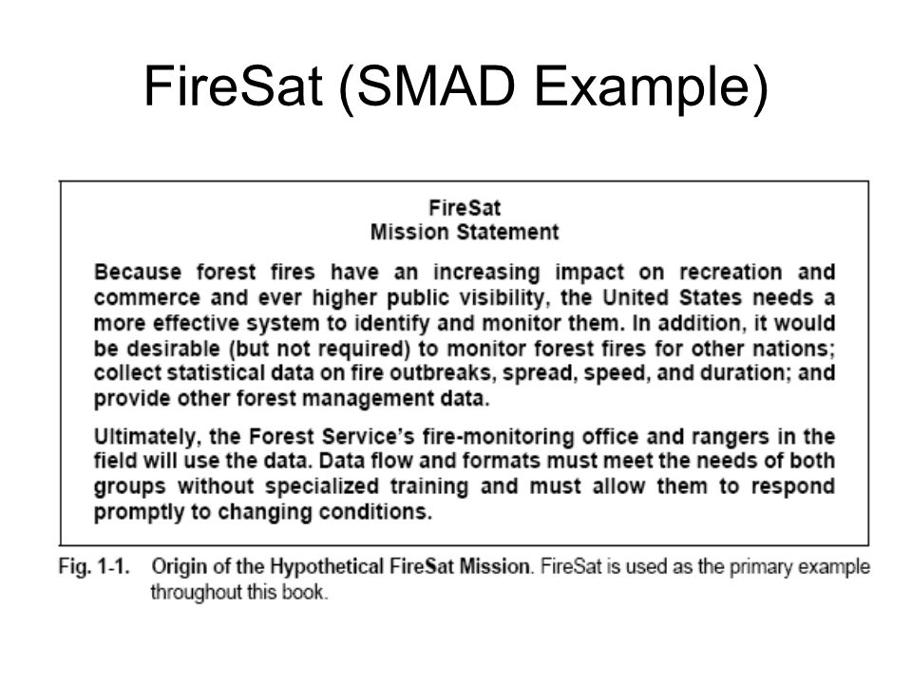

Slide 38
FireSat Requirements & Constraints
Functional Rqmts | Operational Rqmts | Constraints
Performance 30 m resolution 500 m location accuracy Coverage Daily for USA Responsiveness - Send registered data within 30 min of detecting fire to up to 50 users Secondary Mission 4 temperature levels for pest management | Duration - At leat 5 yrs Availability 98% excluding weather 3-day maximum outage Timeliness Survivability - Natural environment only Data Distribution - Up to 500 fire-monitoring office & 2000 rangers worldwide with a max of 100 simultaneous users Data Content, Form, & Format Location and extent of fire on any of 12 map bases Average temperature for each 30 square meter grid Data Storage | Cost - <$20 million/yr plus R&D costs Schedule IOC in 5 yrs FOC in 6 yrs Regulations - NASA mission (federal regs and procurement constraints apply) Political Limits - Responsive to public demand for actions Economic Return Environment Interfaces - Communication relay and interoperable through NOAA ground stations Development Constraints Launch on Shuttle or expendable No unique operations people at data distribution nodes Spacecraft Disposal

Slide 39
Astr Engr 423 Space Mission Design
Astr Engr 423. Space Mission Design. 3(1). An advanced mission design course for civilian and military space applications. The course focuses on applying numerical and analytical techniques to solve realistic problems for space missions involving maneuvering and trajectory design. Topics include advanced proximity operations, cislunar trajectories, hypersonic reentry, and other dynamic space operations. Structured computer programming is applied to analyze space missions. Final project. Prereq: Astr Engr 321. Sem hrs: 3 fall.

Slide 40
